Slide 1



Slide 2
INFLUXDB SETUP

Slide 3
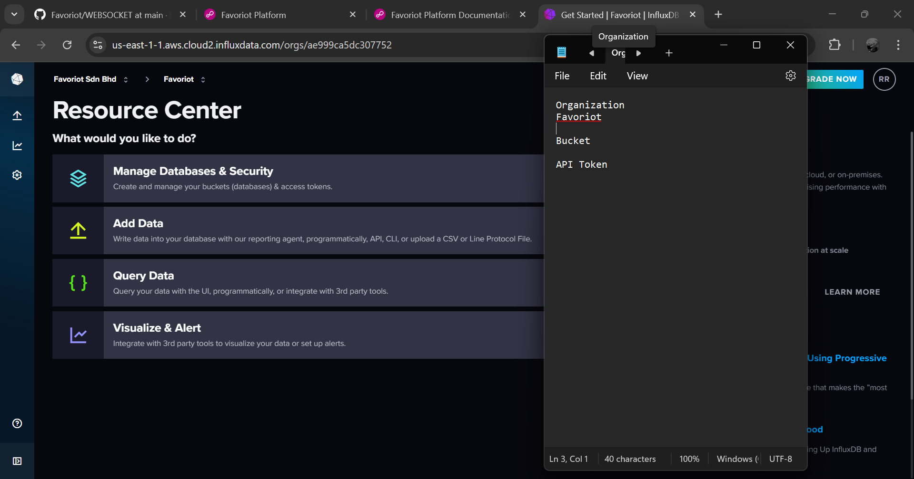
1
Log in to InfluxDB account. Then, write organization name in notepad.

Slide 4
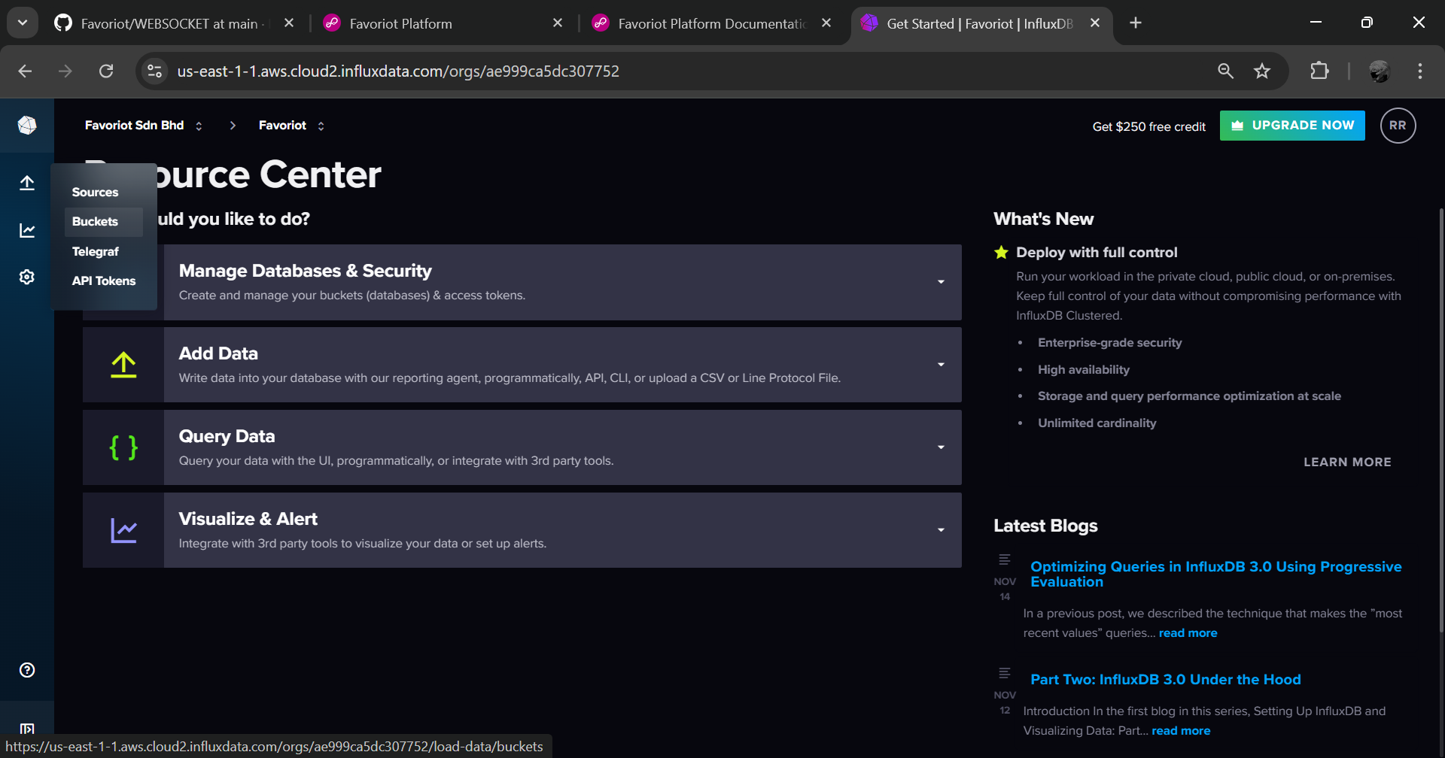
Click load data. Then, select buckets.
1

Slide 5
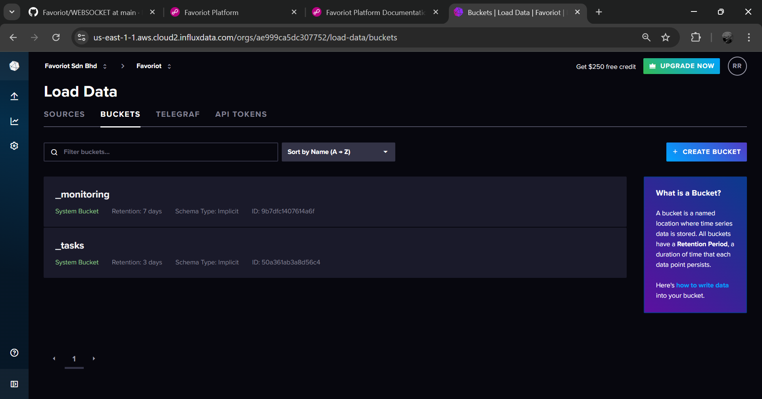
1
Create new bucket.

Slide 6
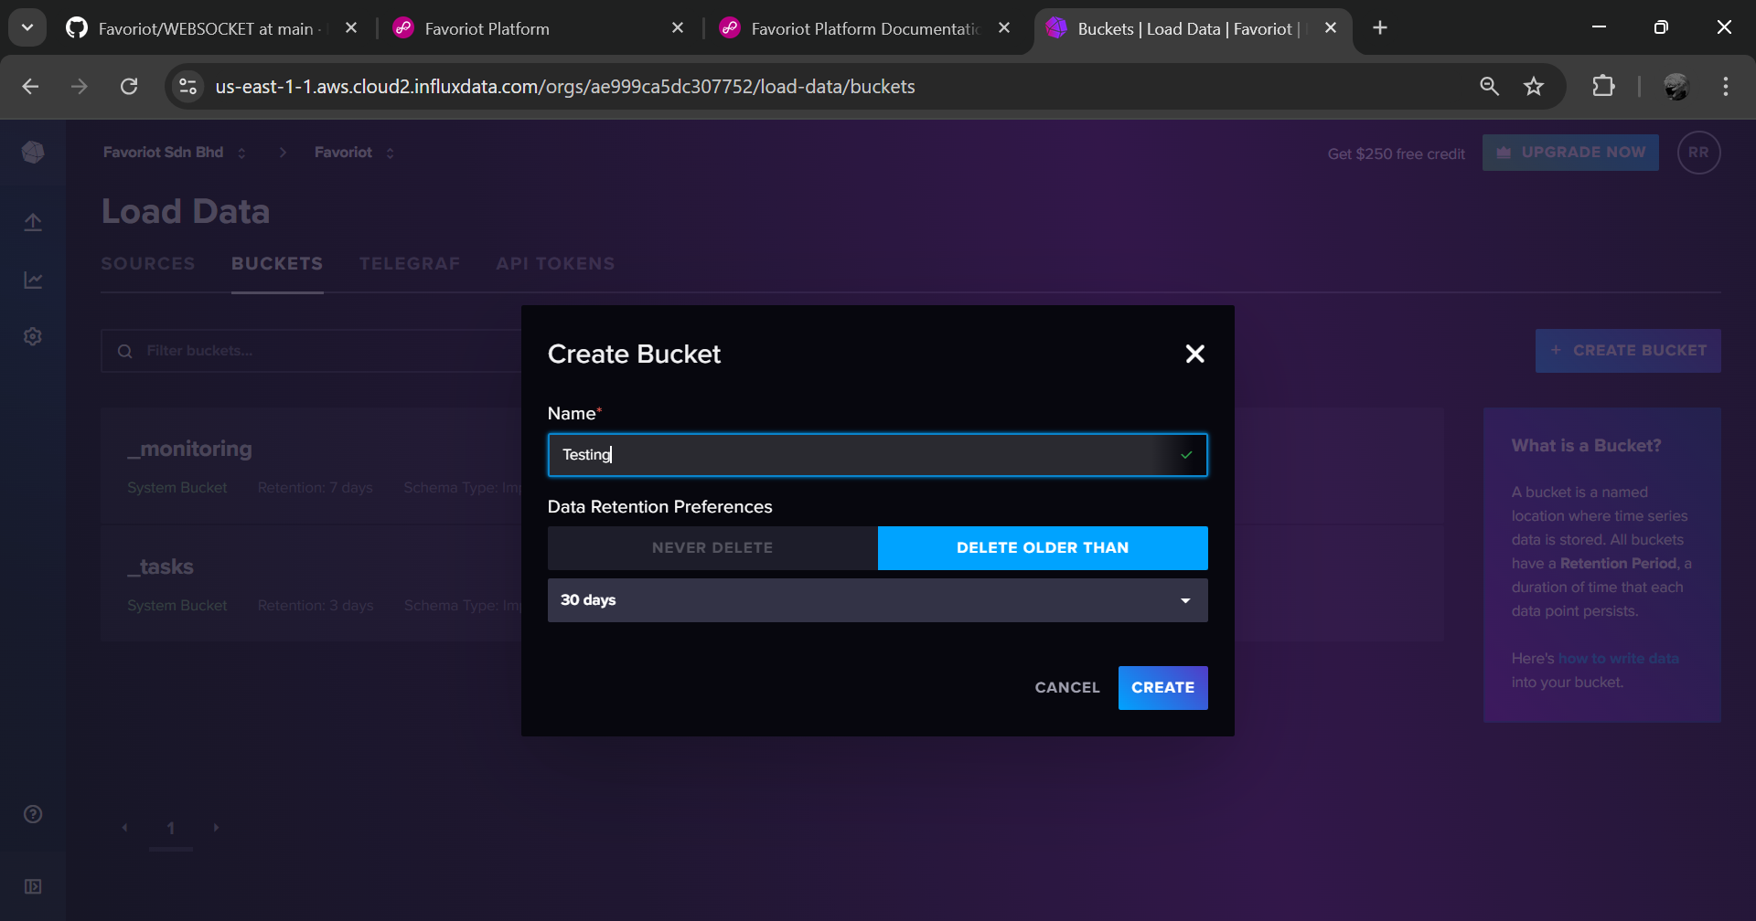
1
Insert bucket’s name.
2
Click create.

Slide 7
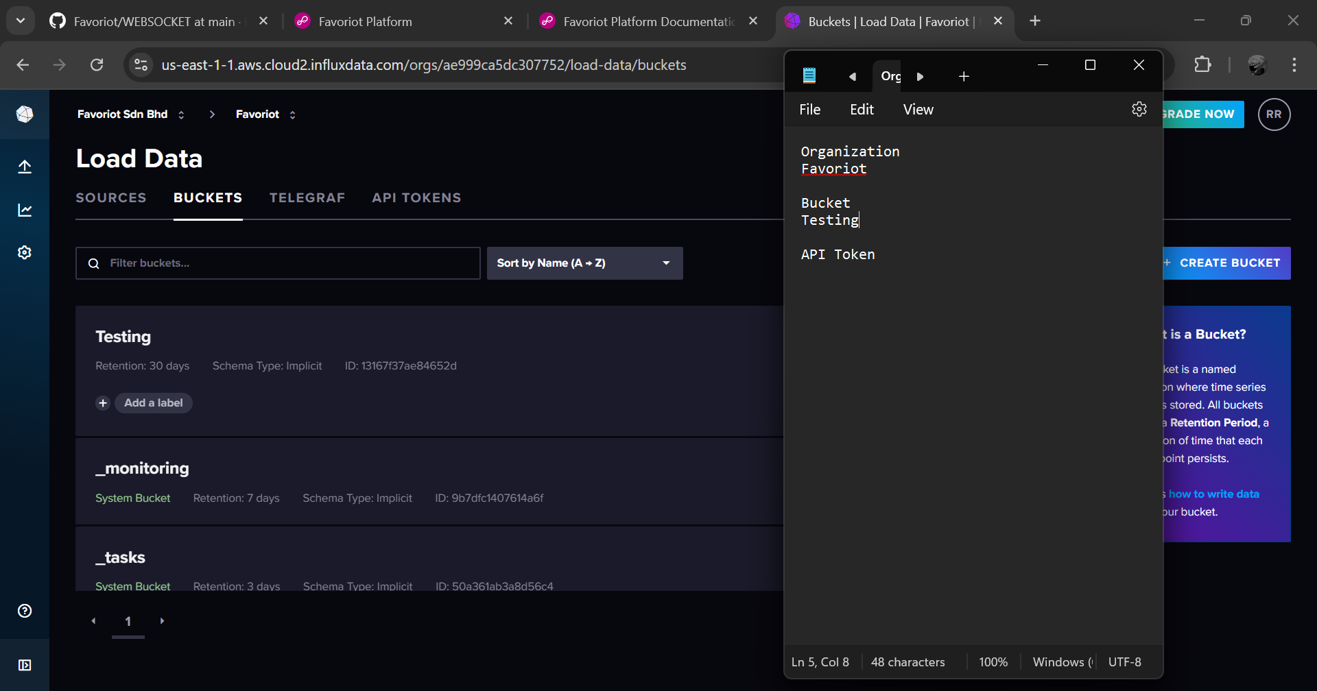
1
Write bucket’s name in notepad.

Slide 8
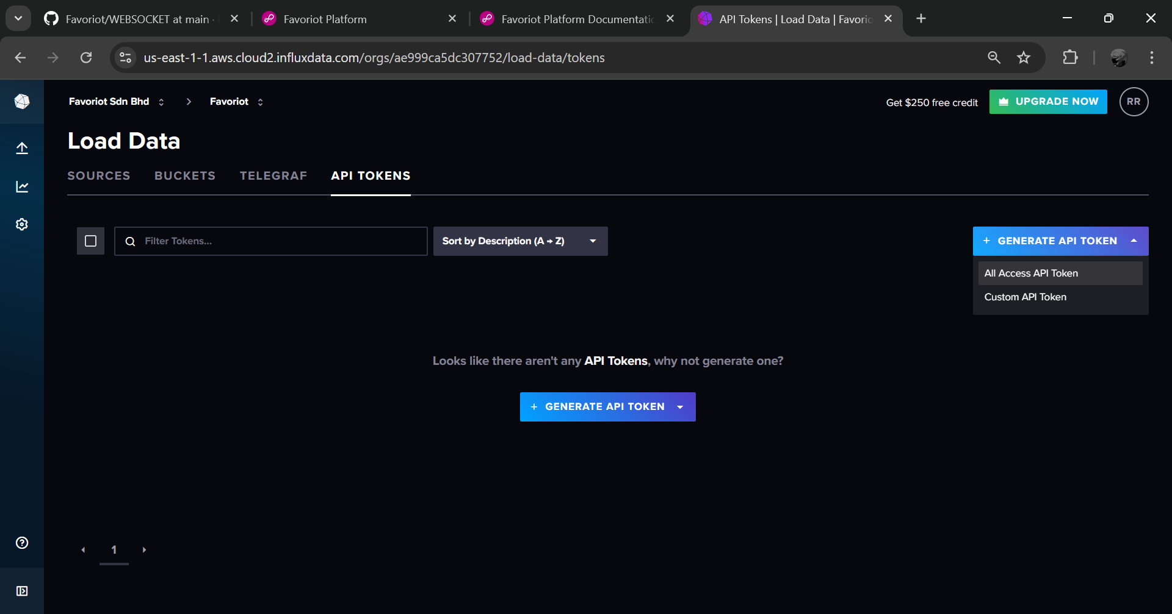
1
Go to API Tokens’ section.
2
Create new all access API token.

Slide 9
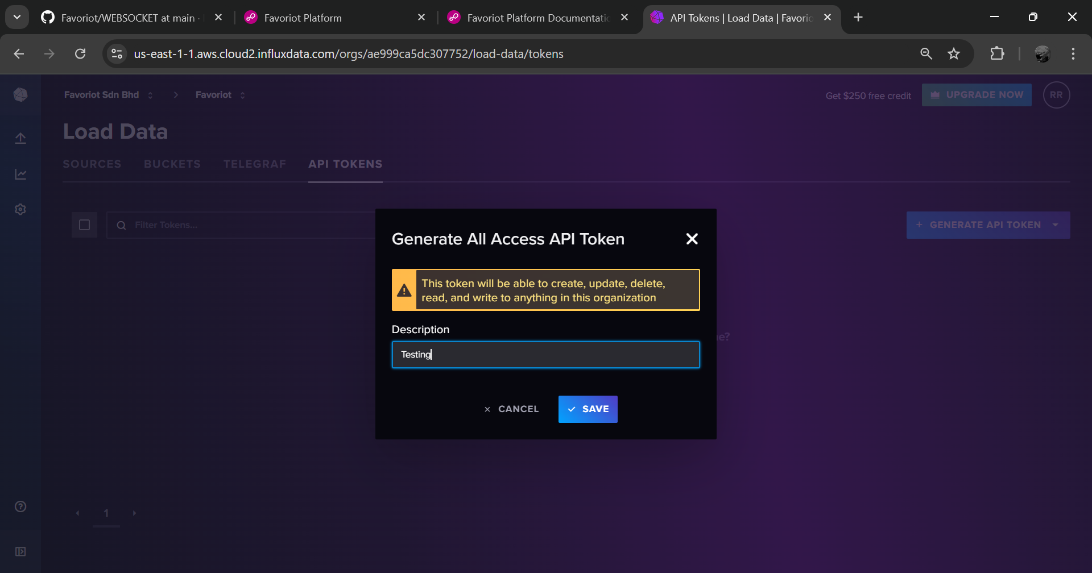
Put the description. Then, click save.
1
2

Slide 10
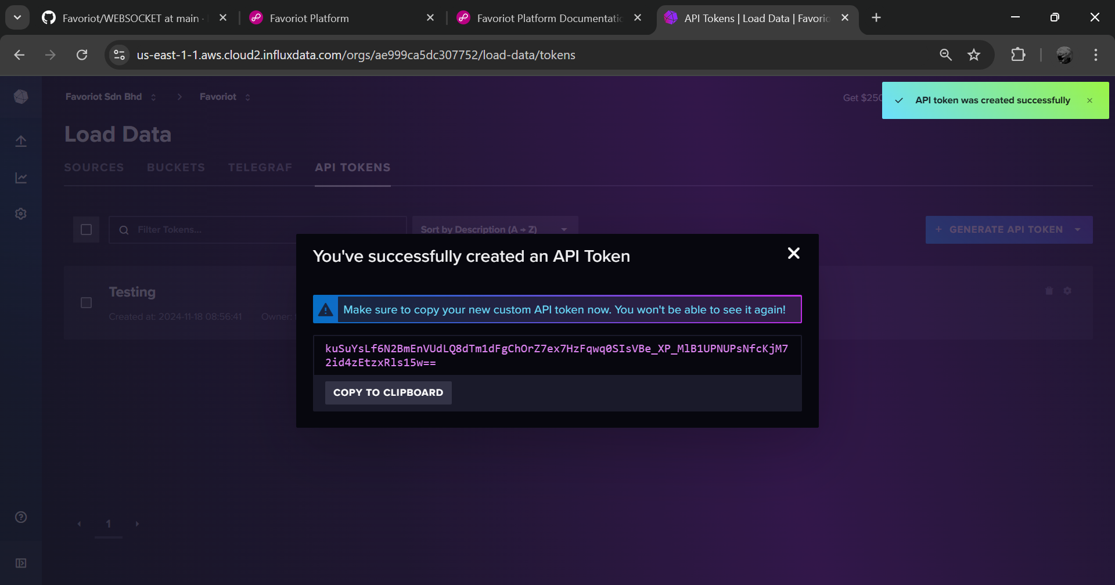
1
Copy the API Token.

Slide 11
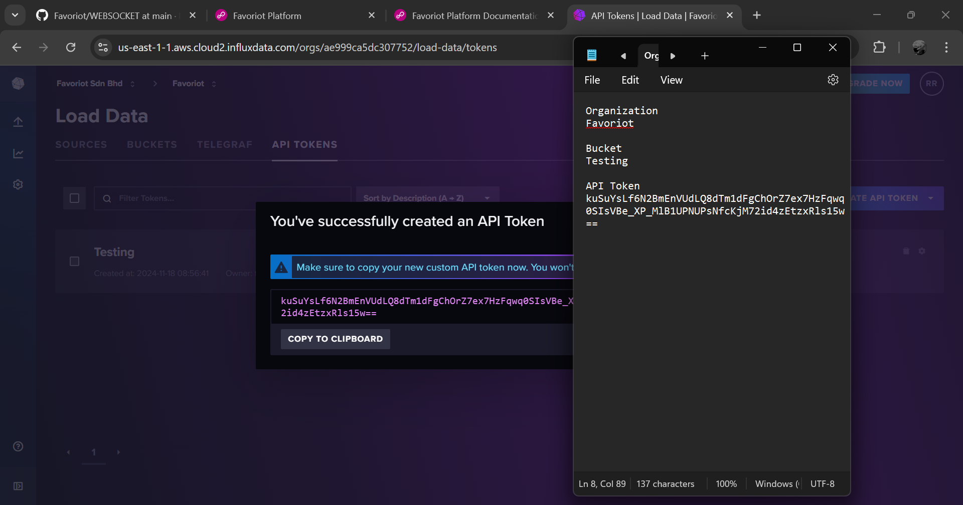
1
Paste the API Token in notepad.

Slide 12
PYTHON CODE

Slide 13
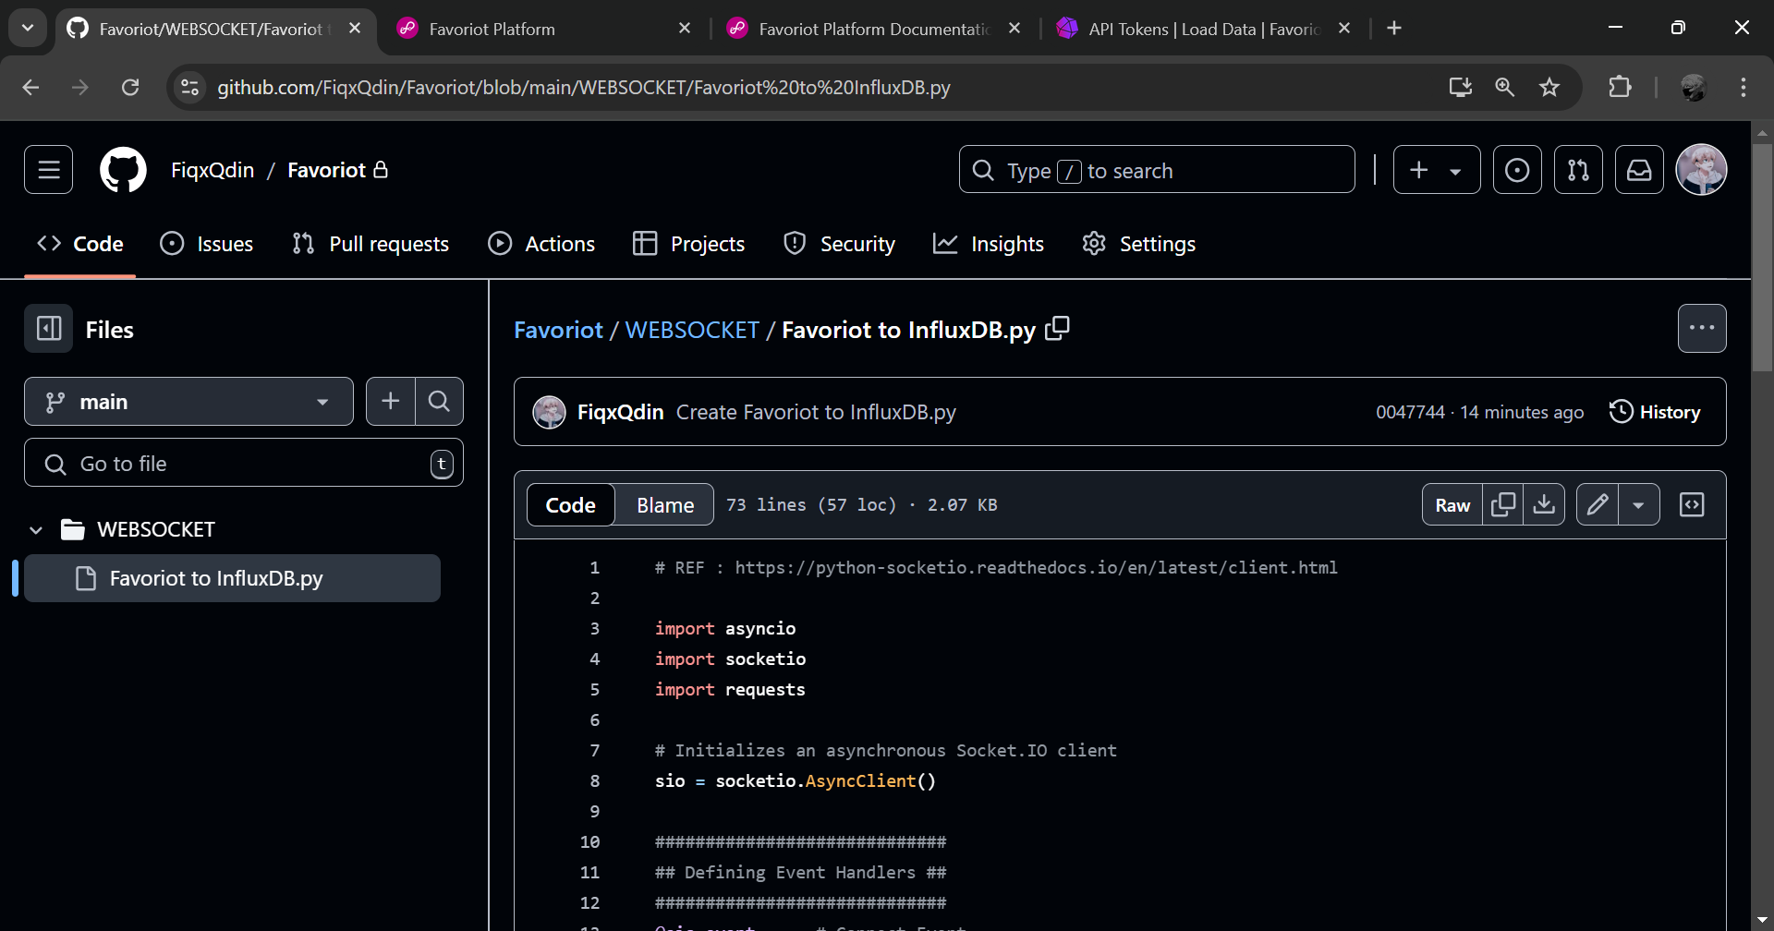
1
Open project code from GITHUB
(https://github.com/FiqxQdin/Favoriot/blob/main/WEBSOCKET/Favoriot%20to%20InfluxDB.py).
Then, copy the code.

Slide 14
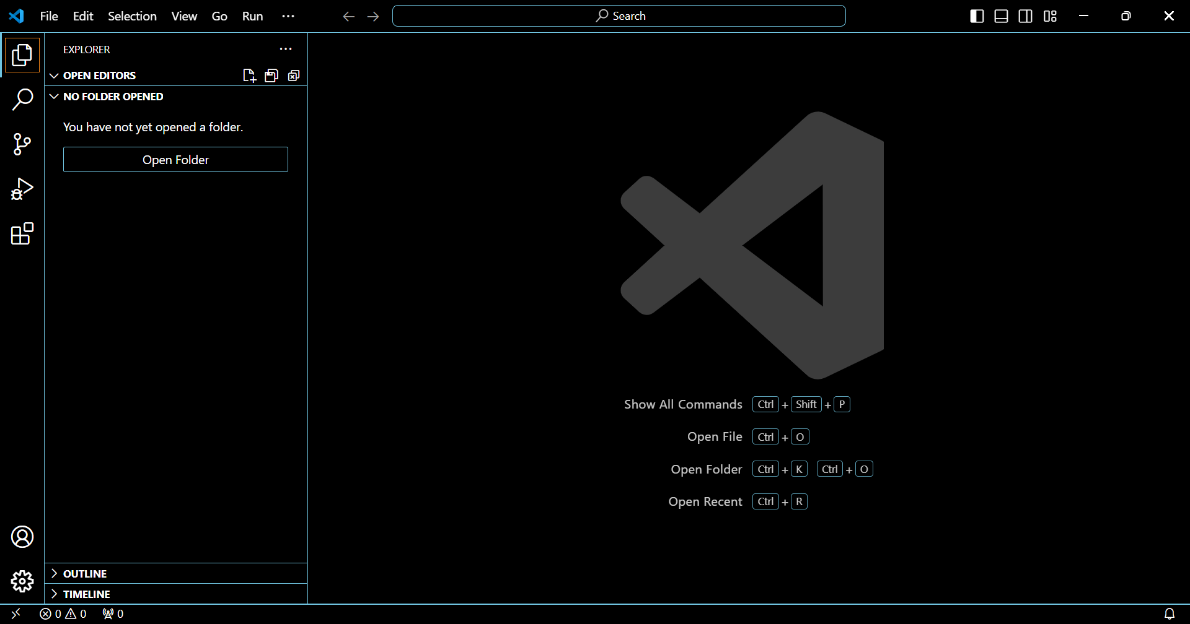
1
Open VS Code. Then, click explorer.
2
Open project’s folder.

Slide 15
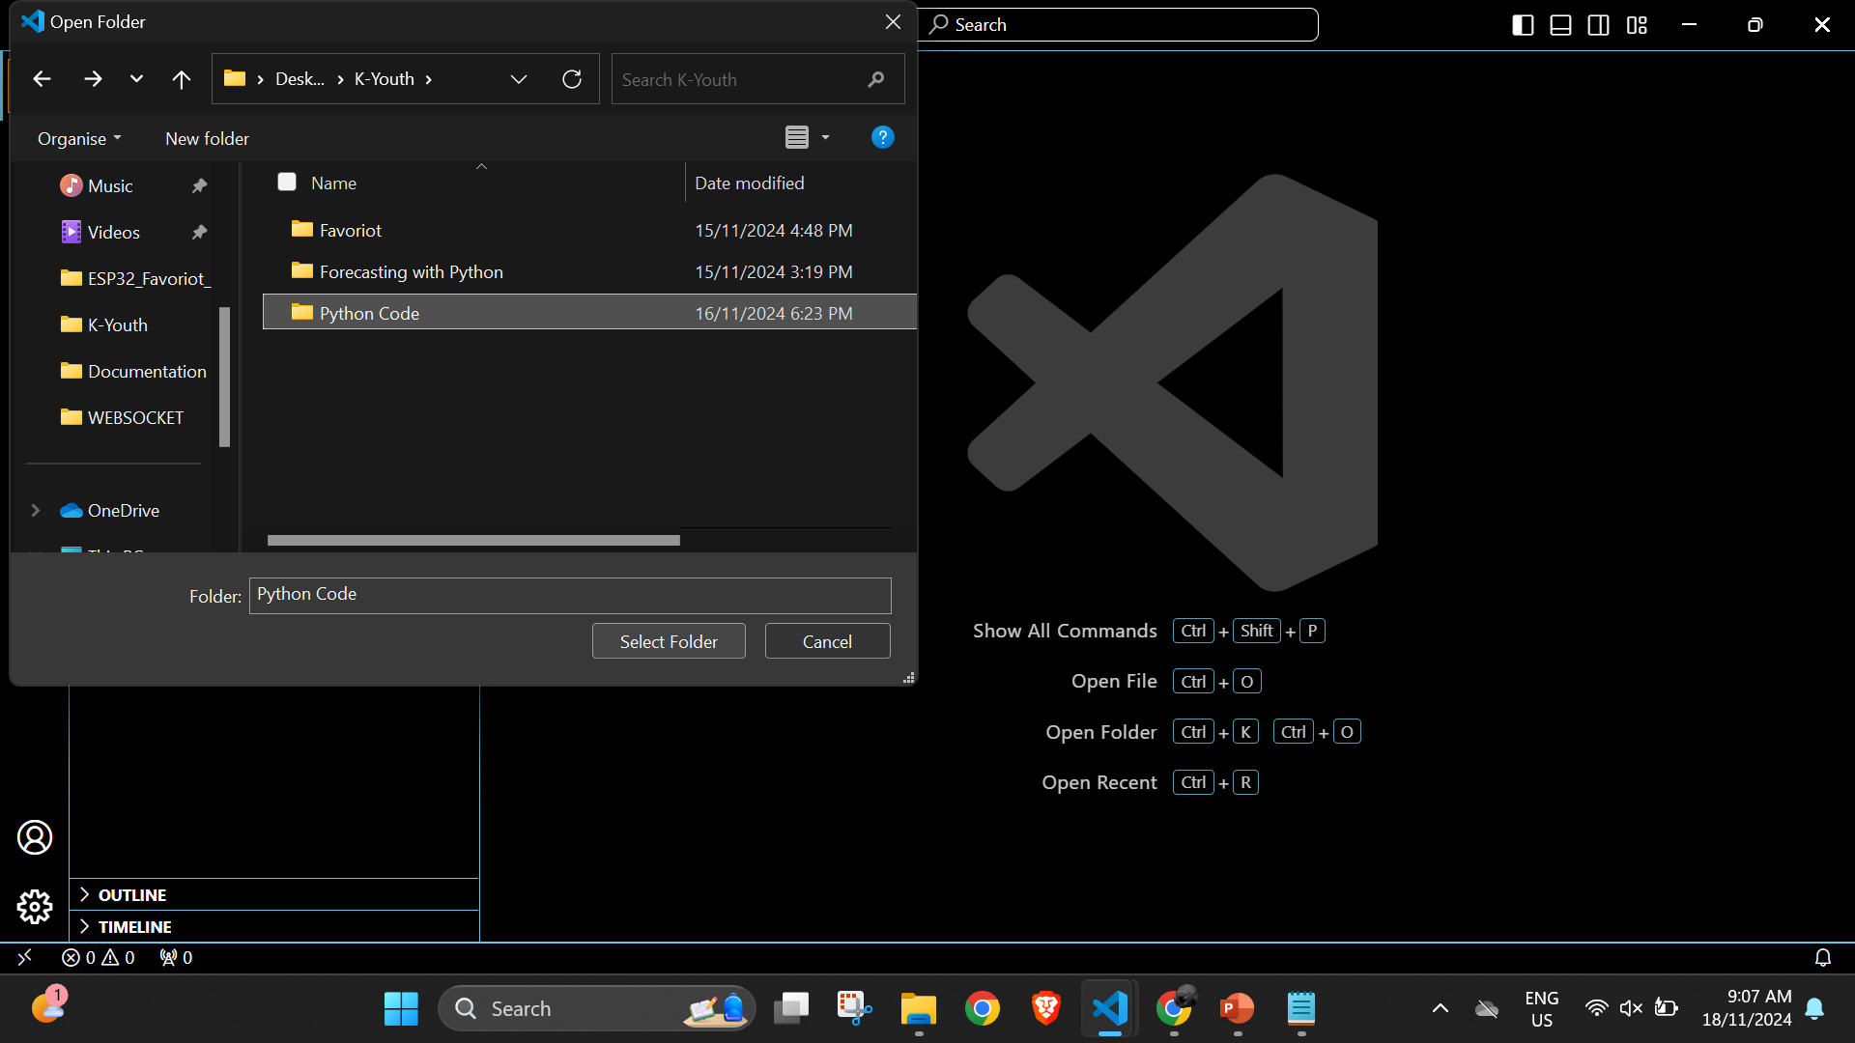
1
Select folder.

Slide 16
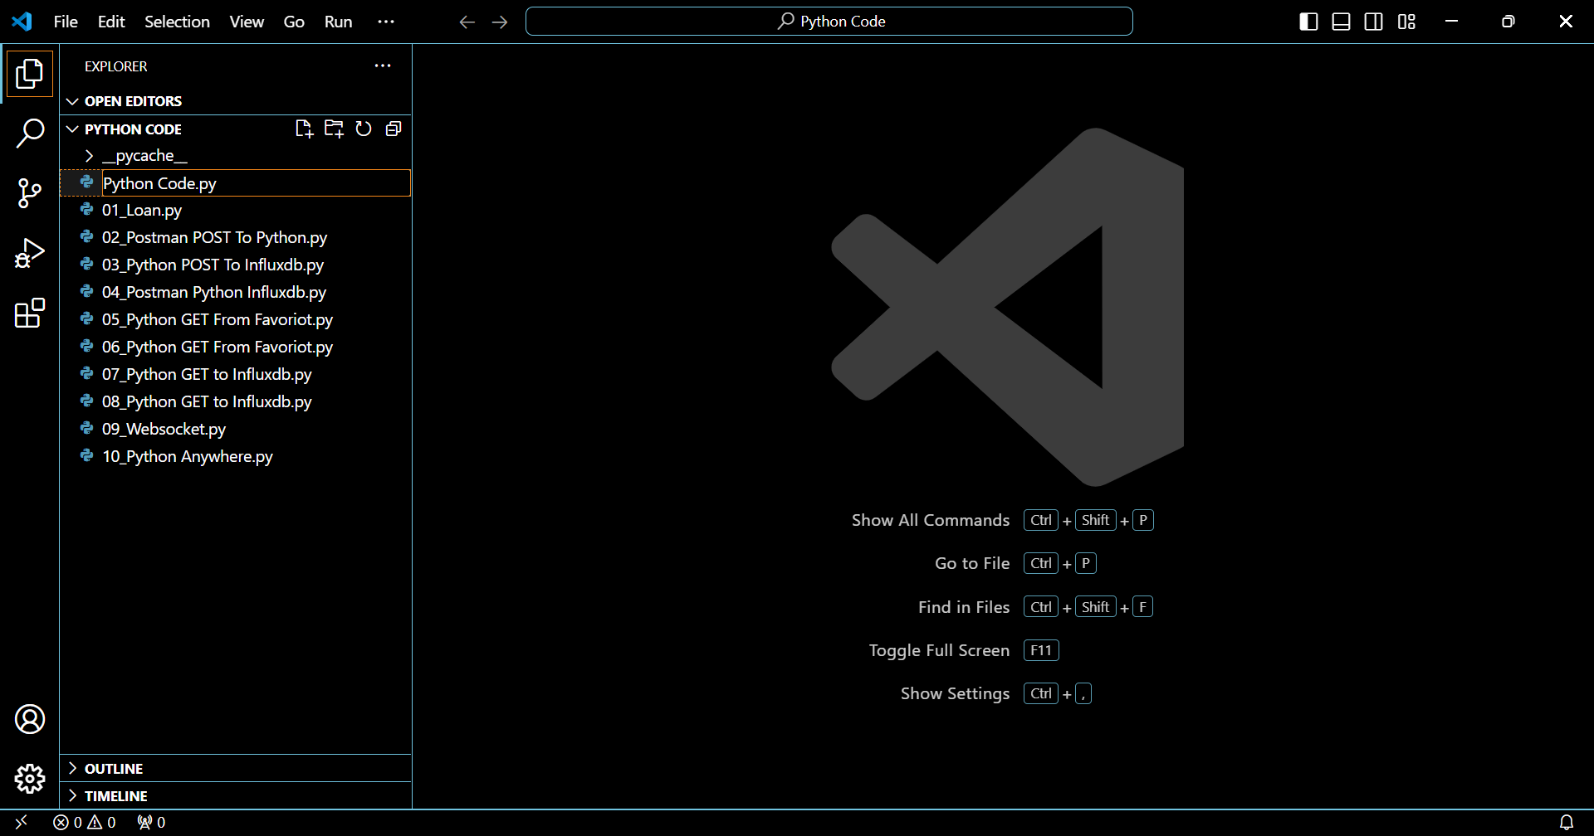
1
2
Create new python file. Then, naming the file.

Slide 17
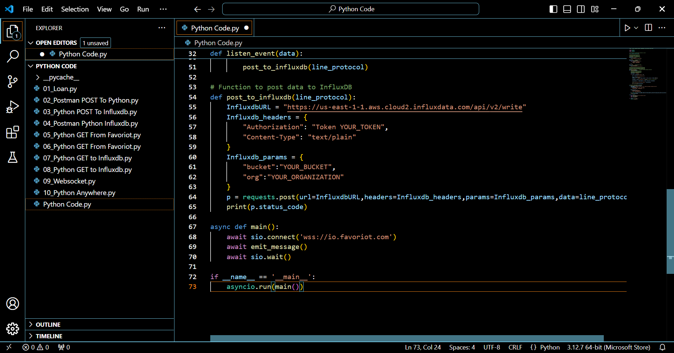
Paste the python code that have been copied from GITHUB.

Slide 18
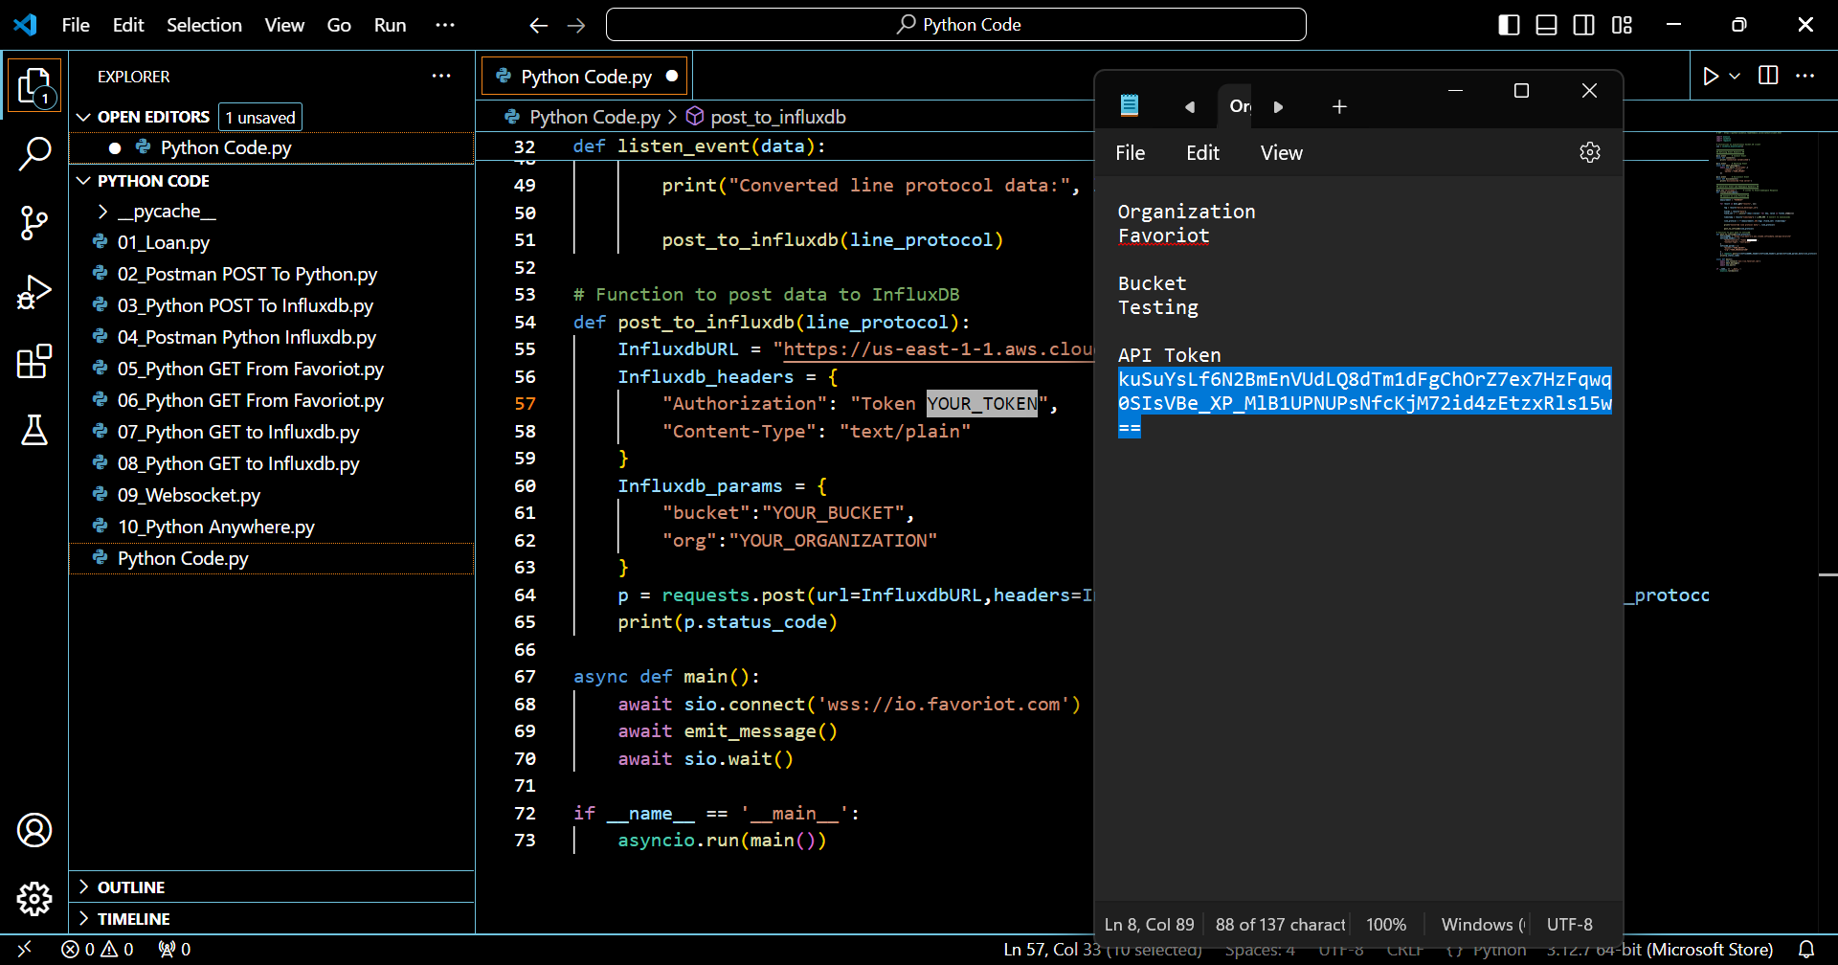
1
Refer to the notepad earlier.

Slide 19
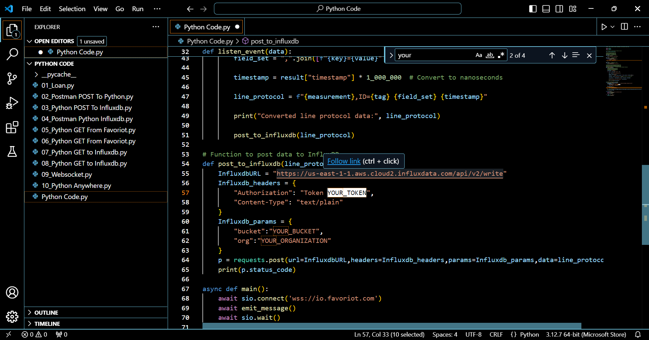
1
Change this to InfluxDB API Token.

Slide 20
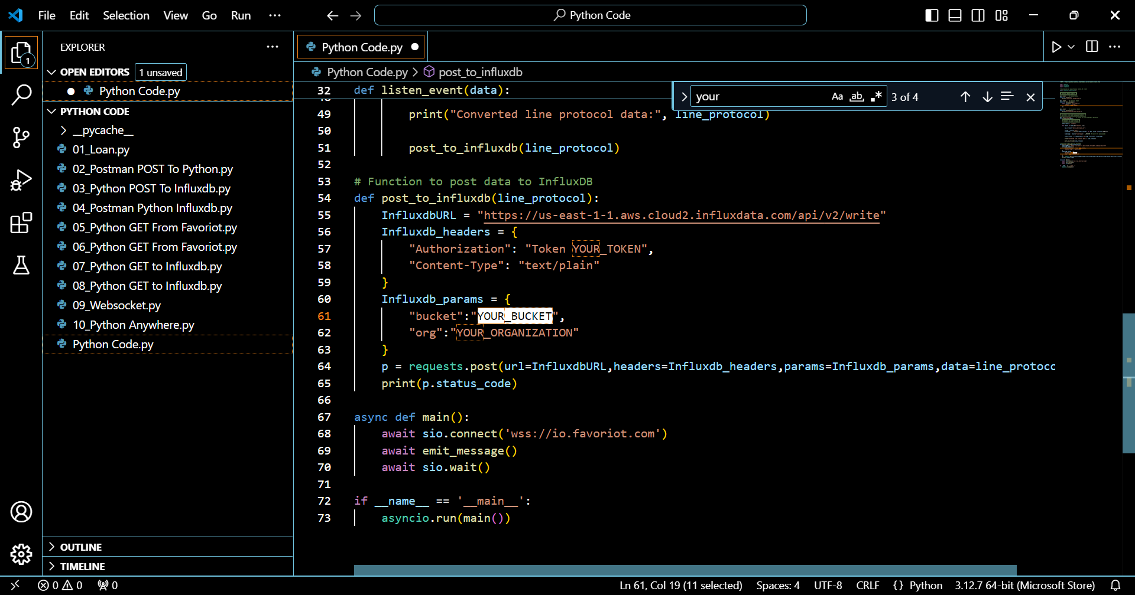
1
Change this to InfluxDB bucket name.

Slide 21
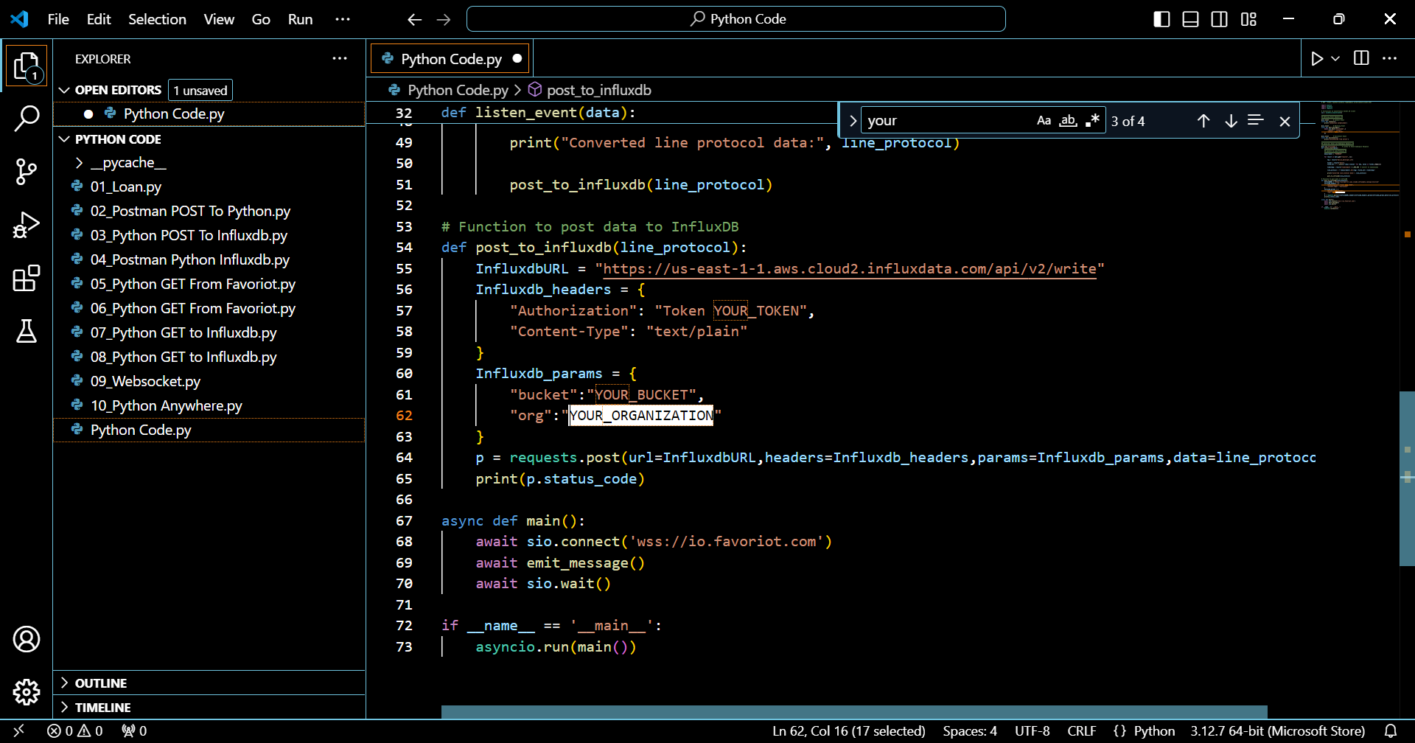
1
Change this to InfluxDB organization name.

Slide 22
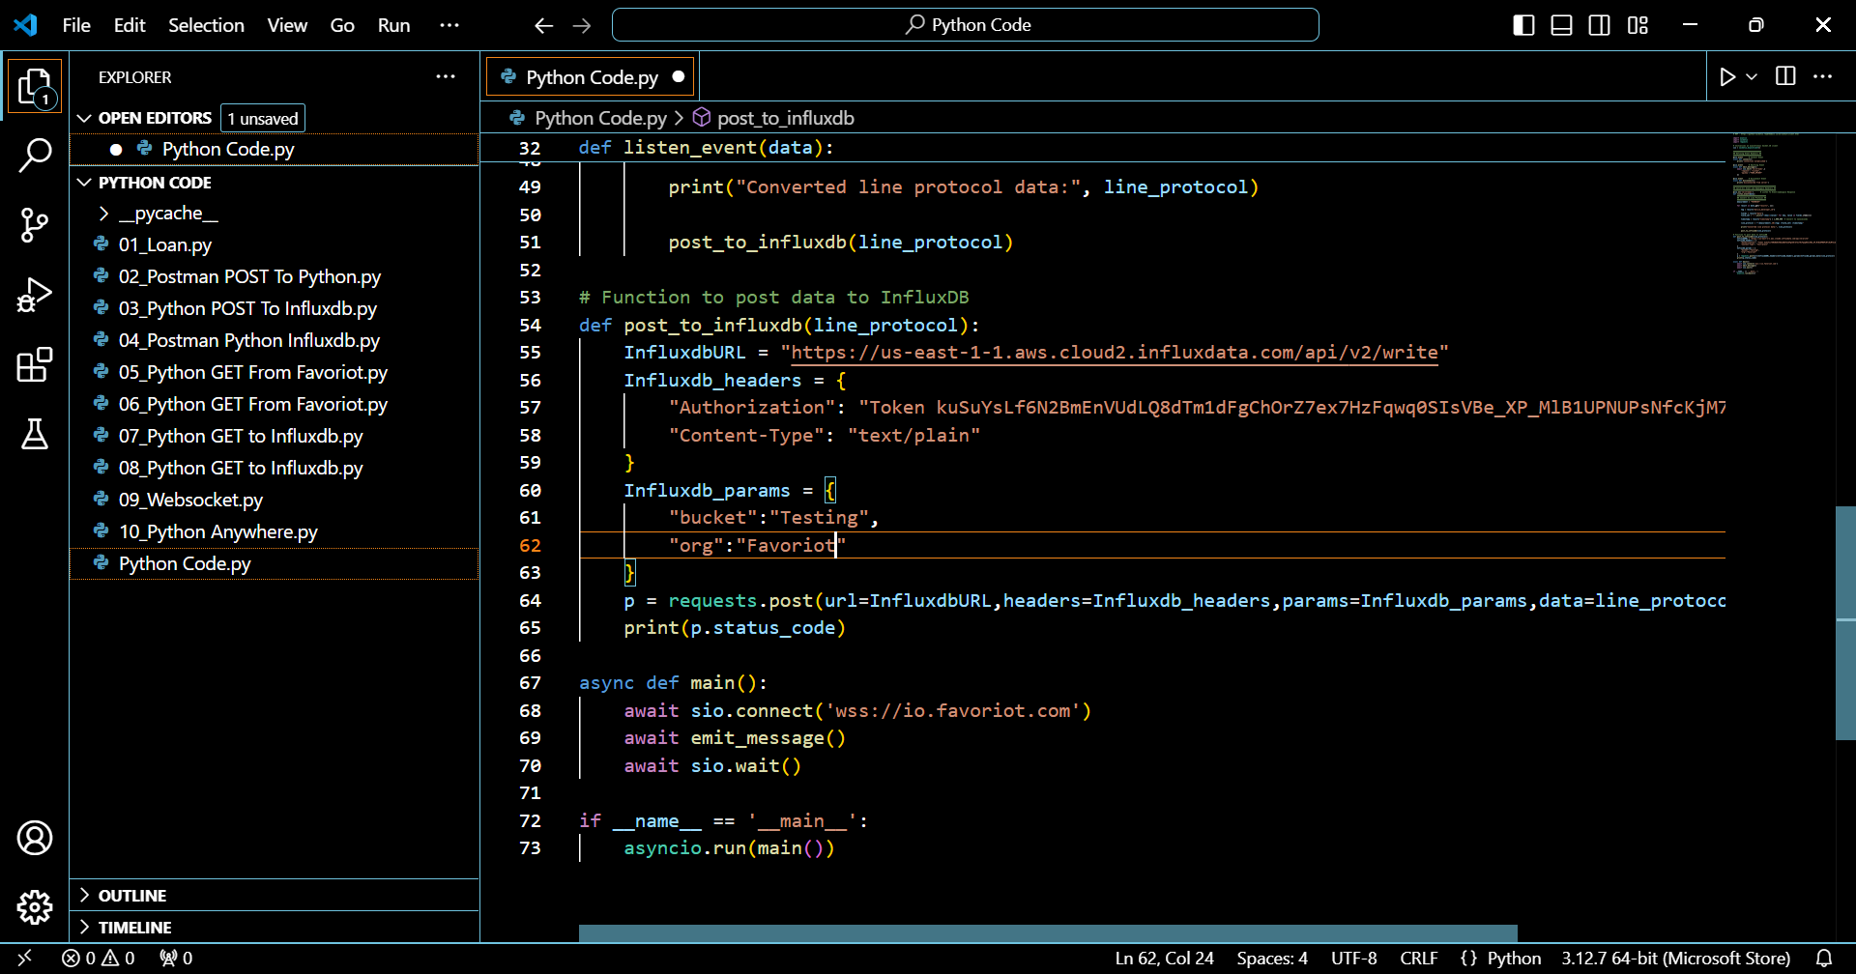

Slide 23
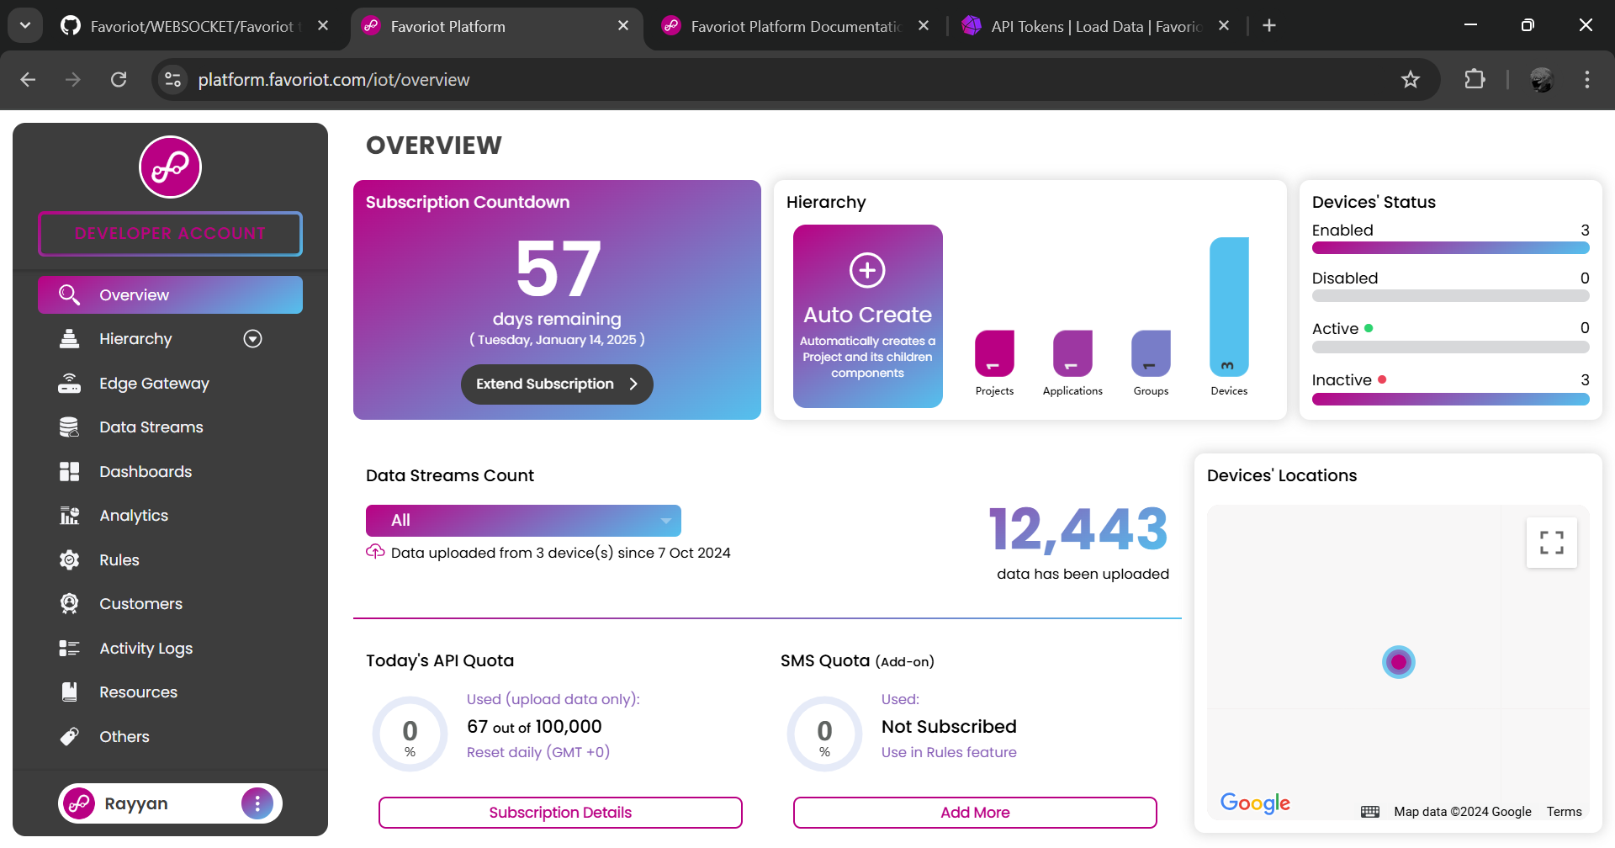
1
Log in to Favoriot account. Then, click developer account.

Slide 24
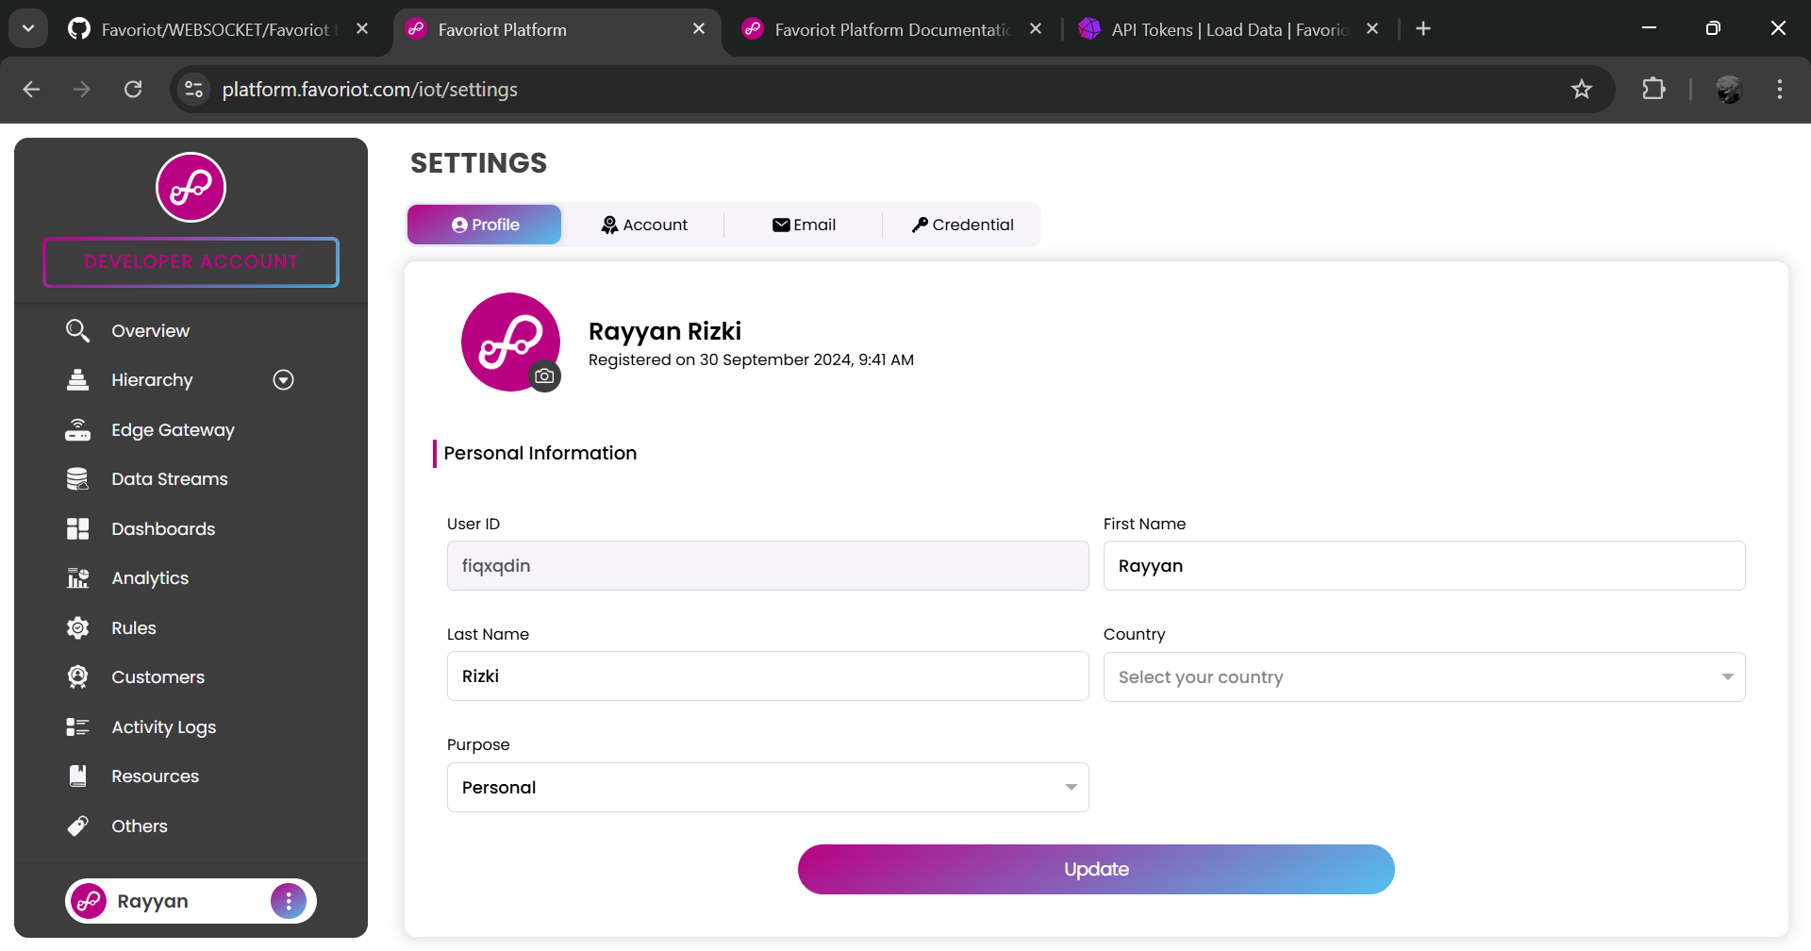
1
Go to account page.

Slide 25
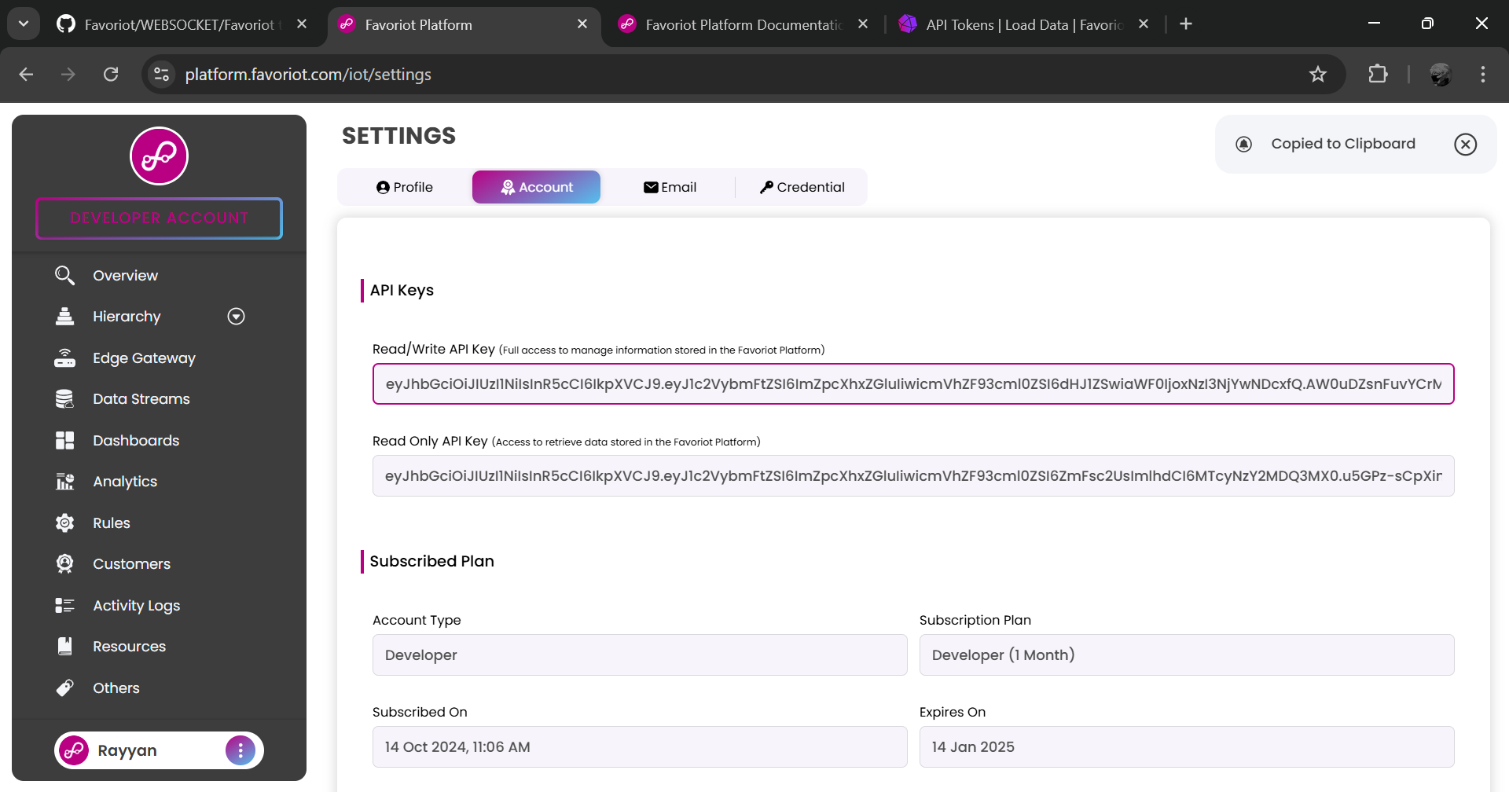
Copy the API key.
1

Slide 26
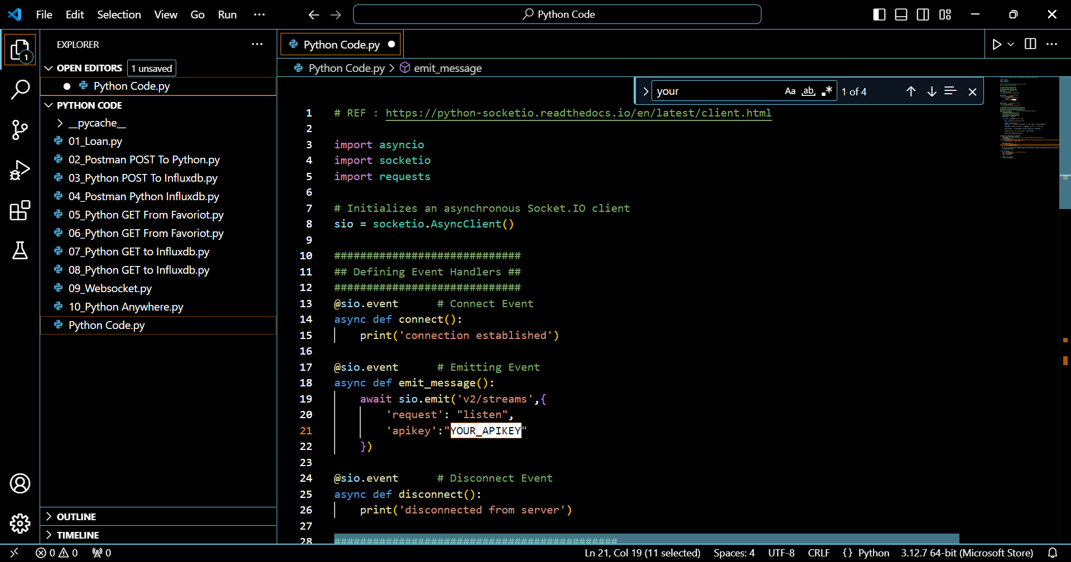
1
Change this to Favoriot API key.

Slide 27
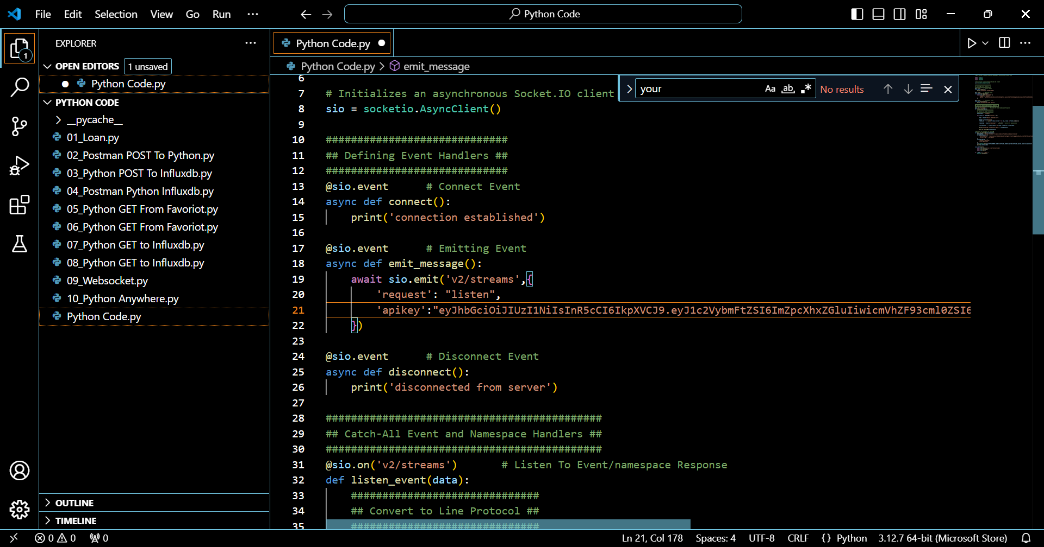

Slide 28
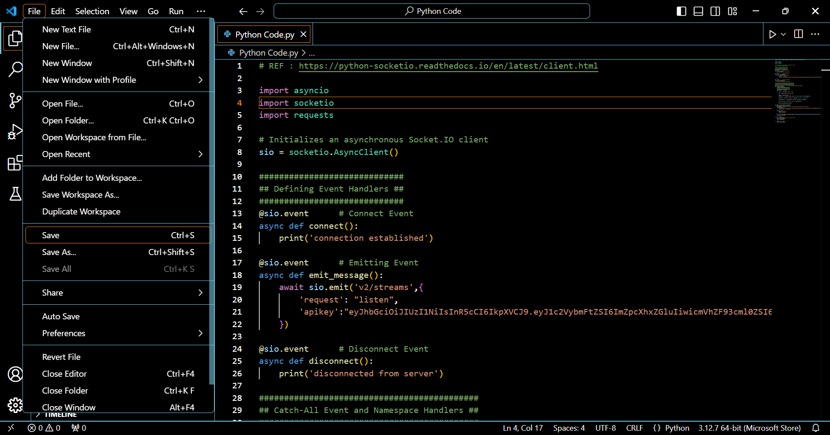
1
Click file. Then, save the python code.
2

Slide 29
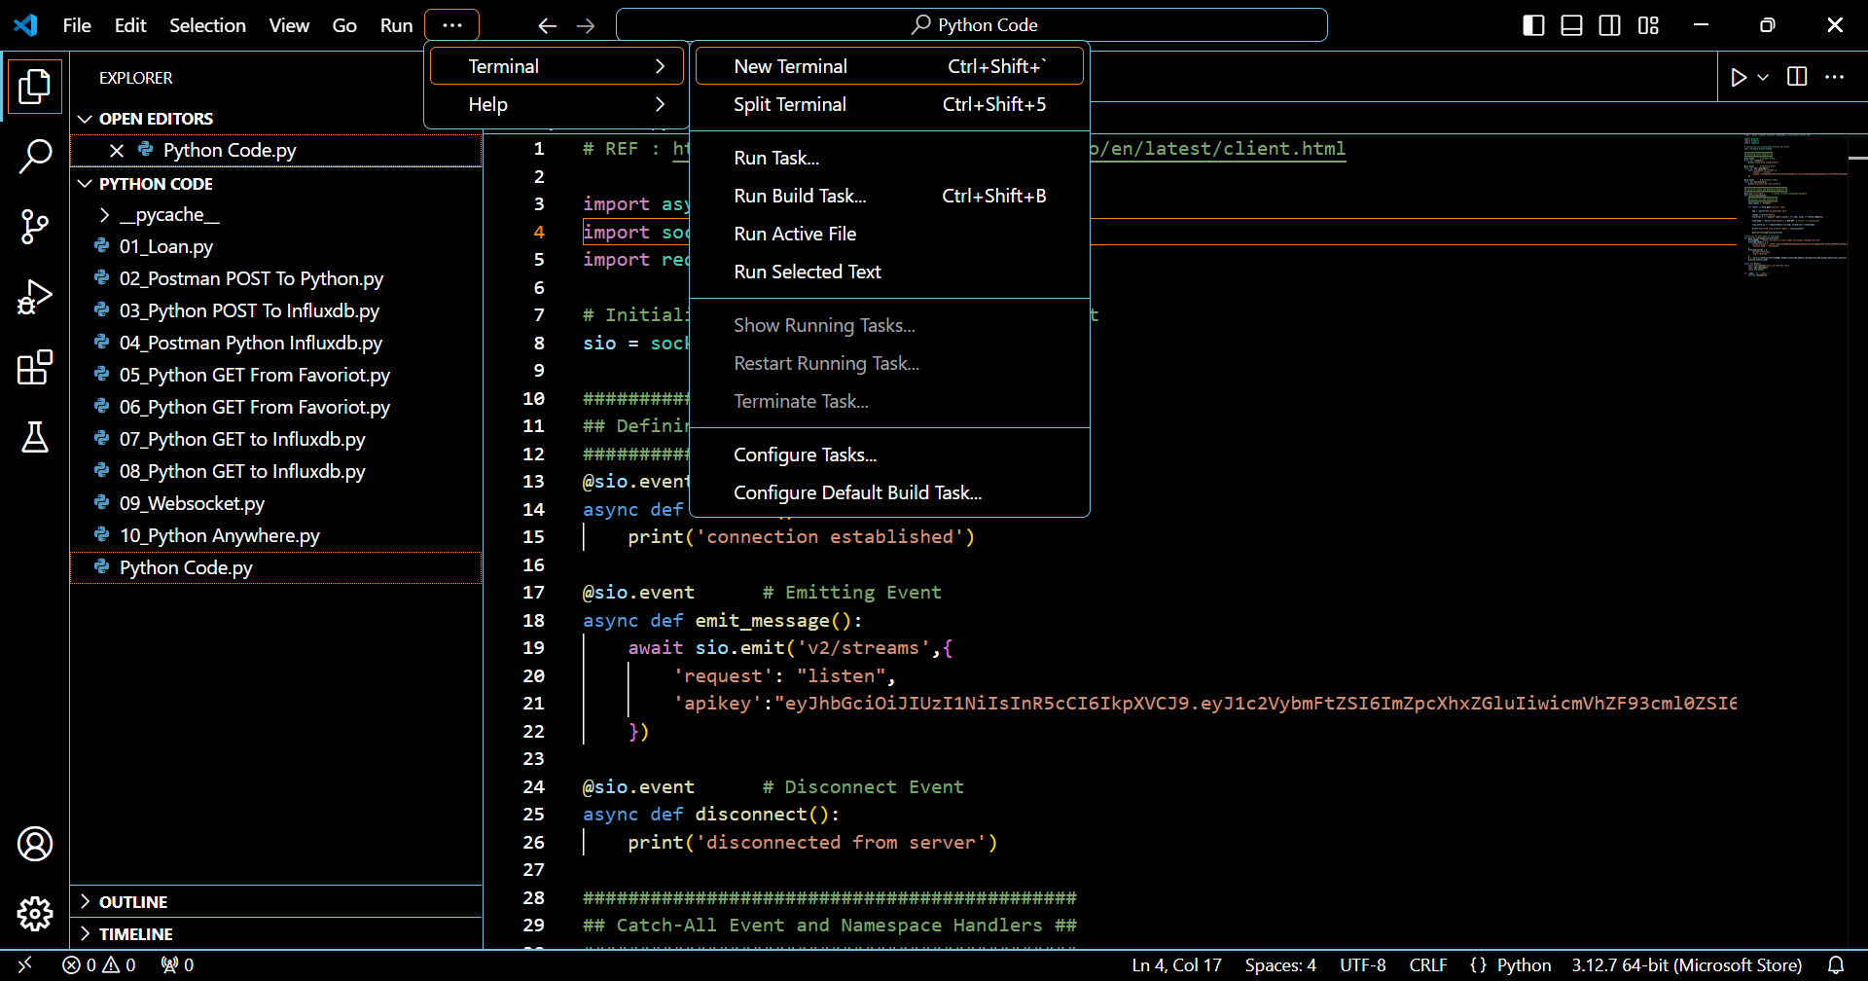
1
Open terminal.

Slide 30
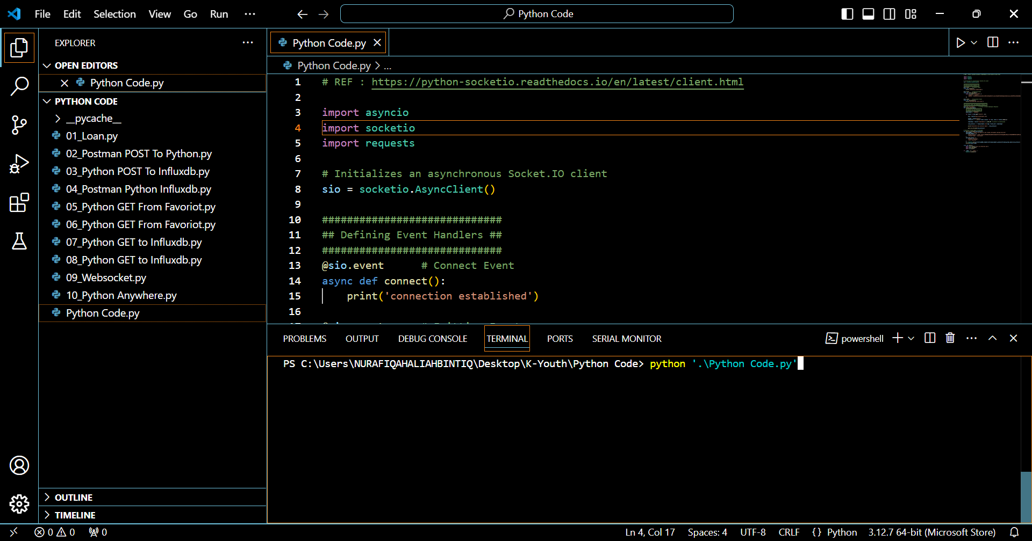
1
Run the python code.

Slide 31
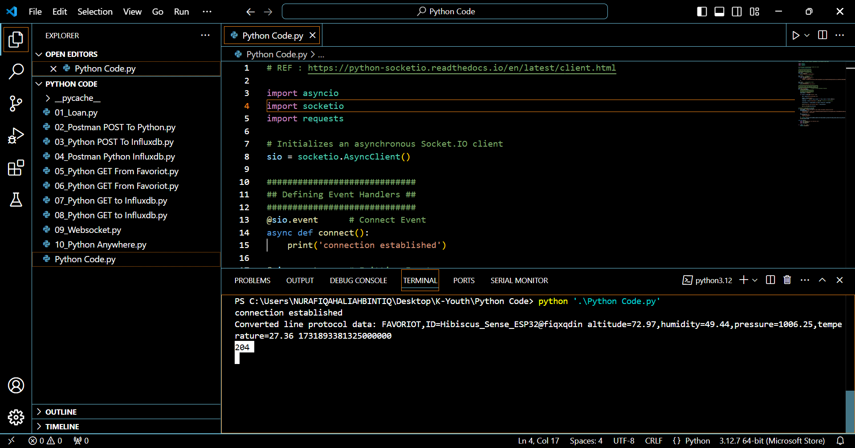
1
If the status code is 204, means that the Favoriot data streams is successfully sent to InfluxDB.

Slide 32
INFLUXDB DATA EXPLORER

Slide 33
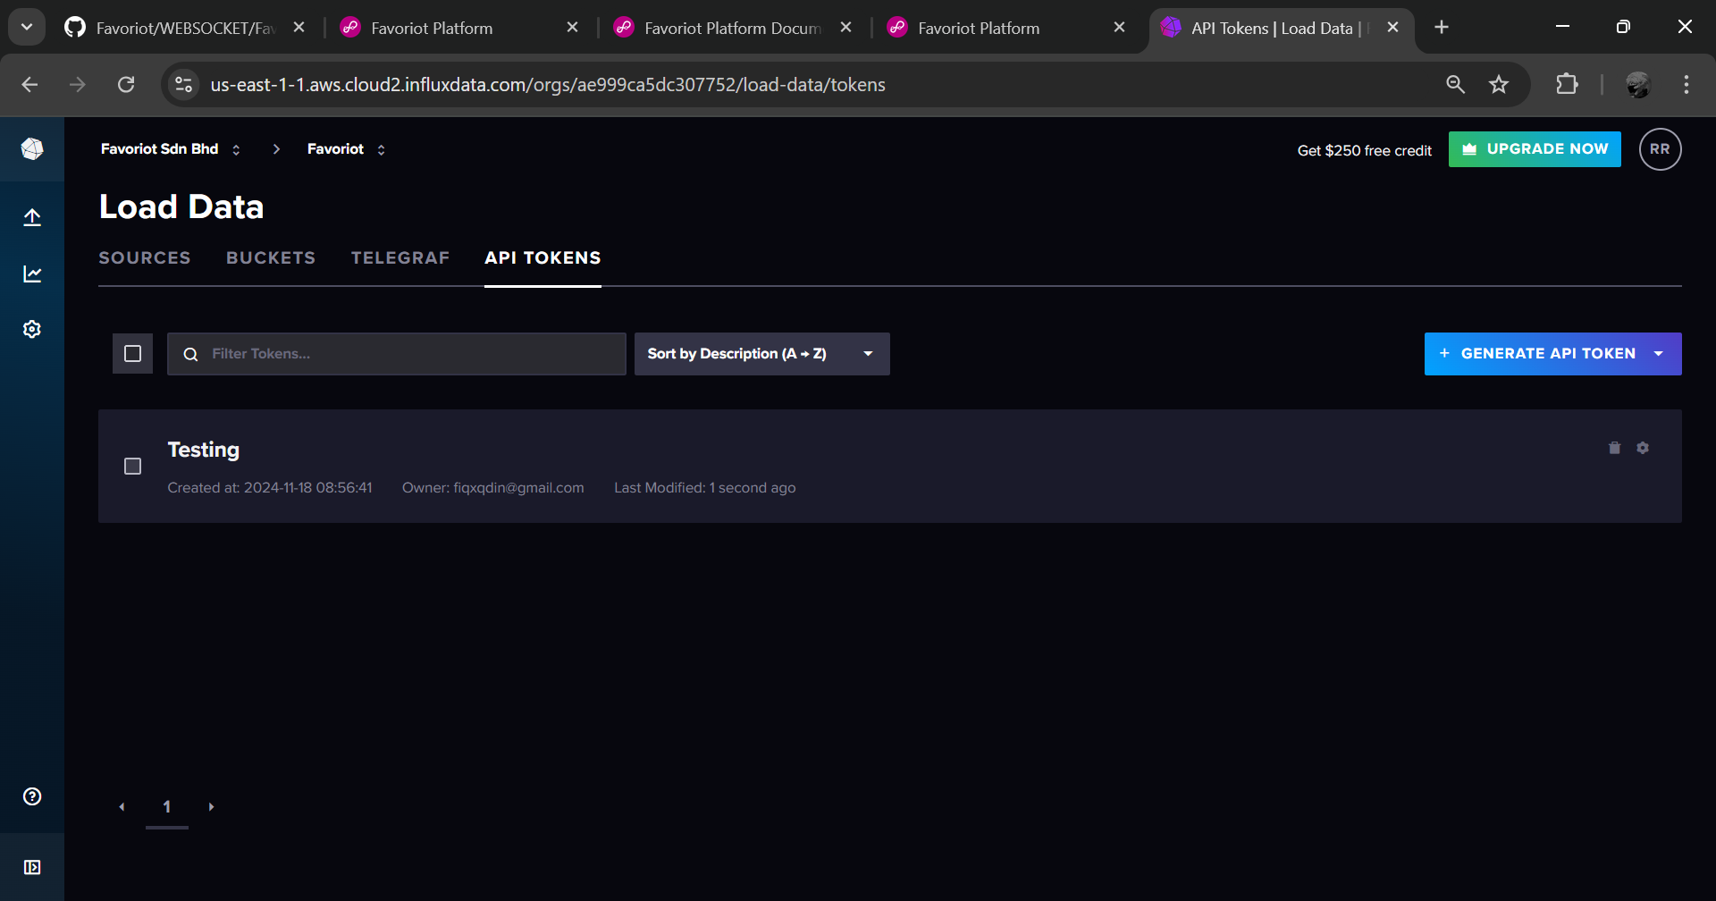
1
Open InfluxDB. Then, click data explorer.

Slide 34
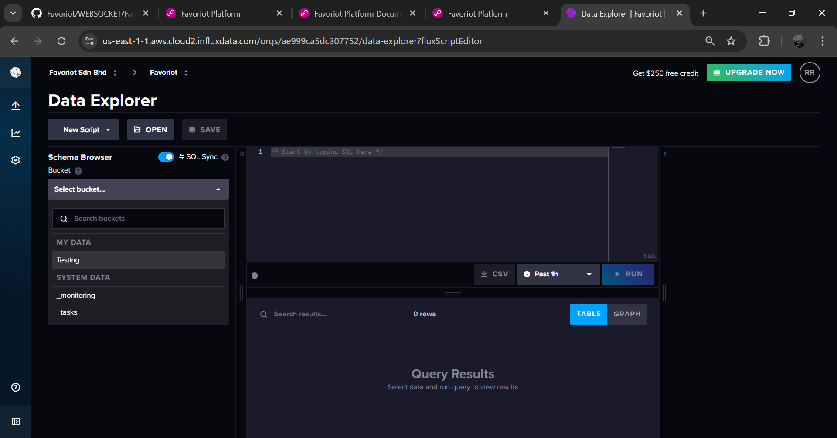
1
Select bucket.

Slide 35
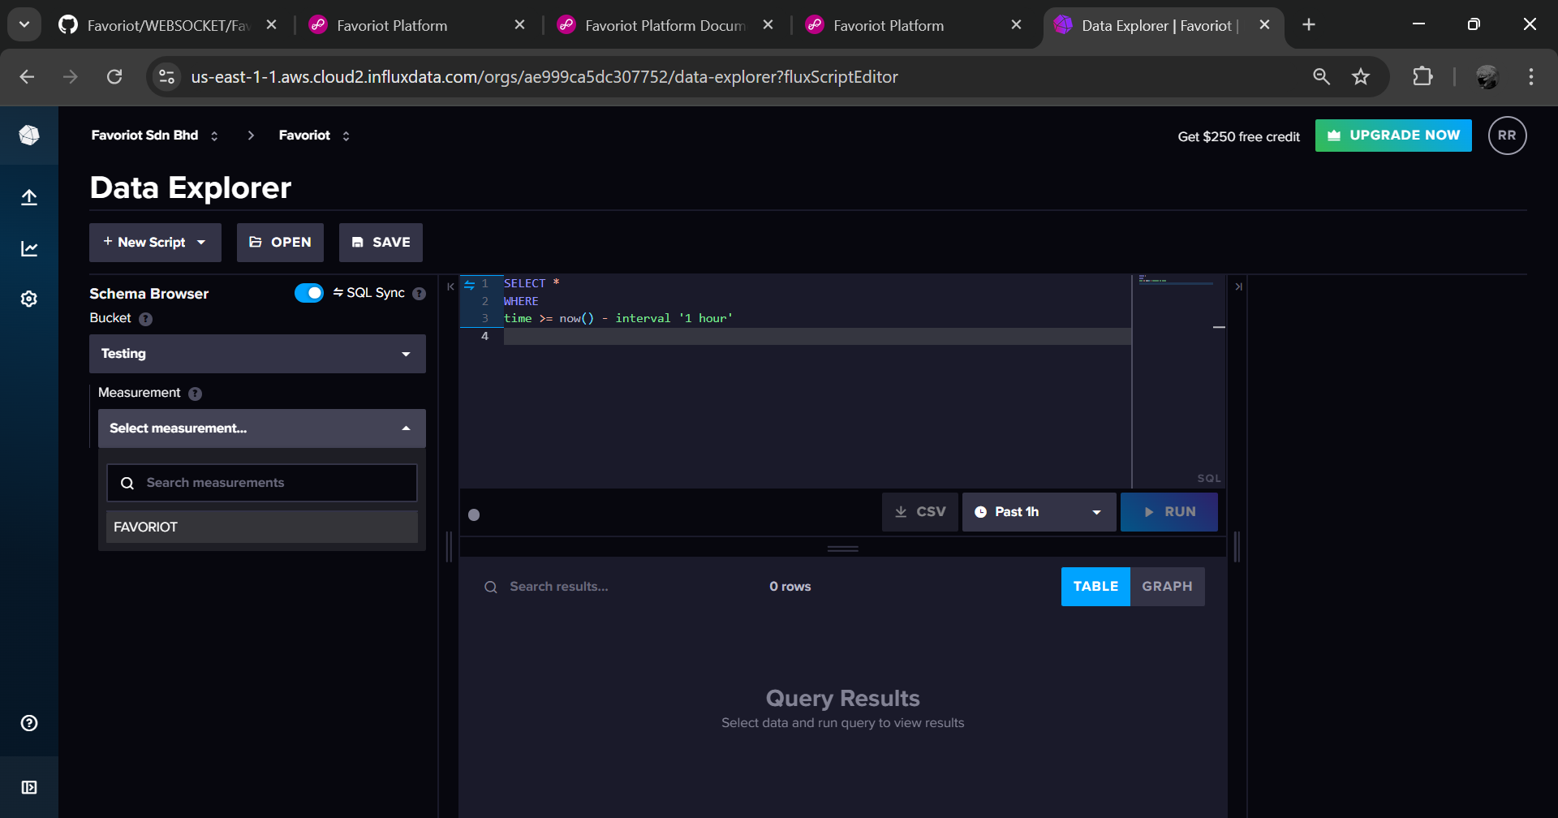
1
Select measurement.

Slide 36
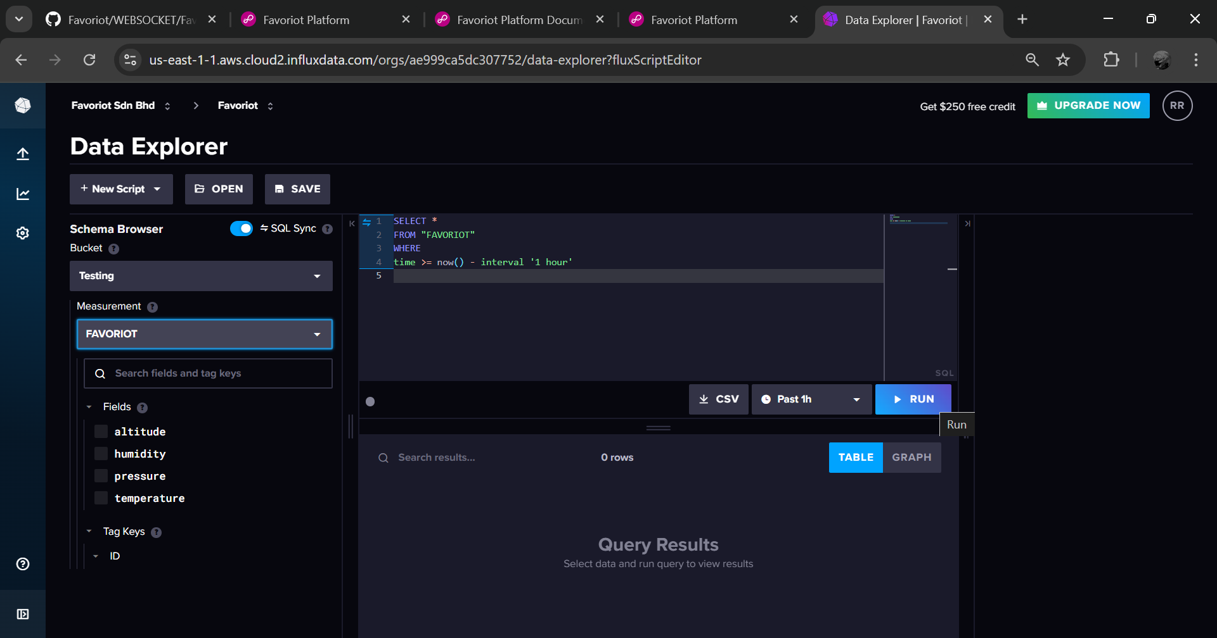
1
Click run.

Slide 37
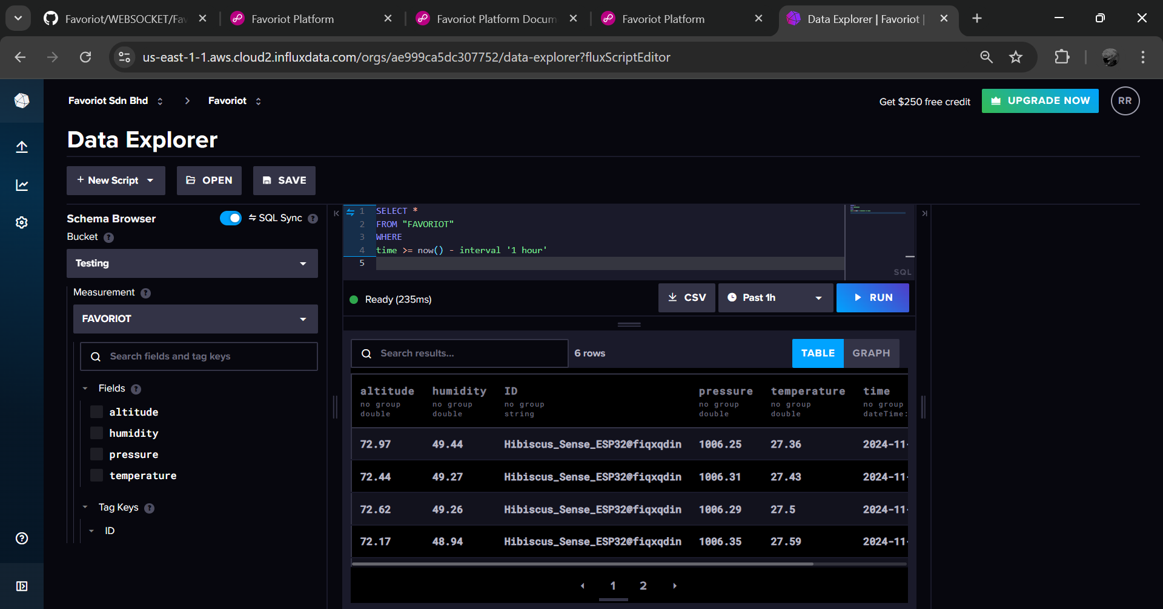
This is the data from Favoriot data streams for past 1 hour.
1

